Slide 1
Representing Graphs and Graph Traversal
Data Structures and Algorithms
Nanjing University, Fall 2020
郑朝栋

Slide 2
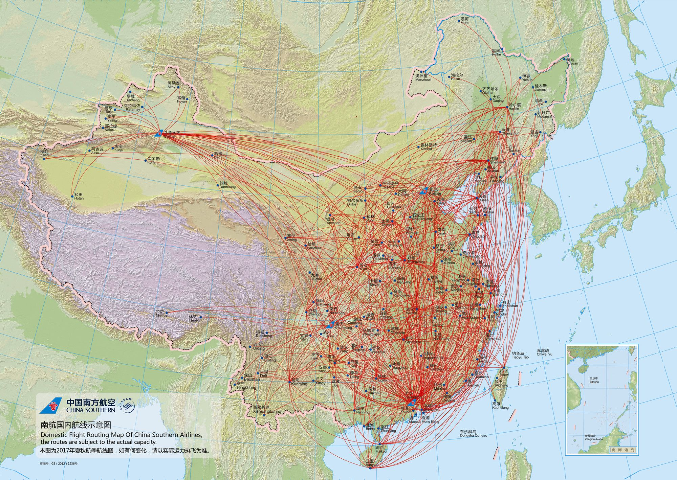

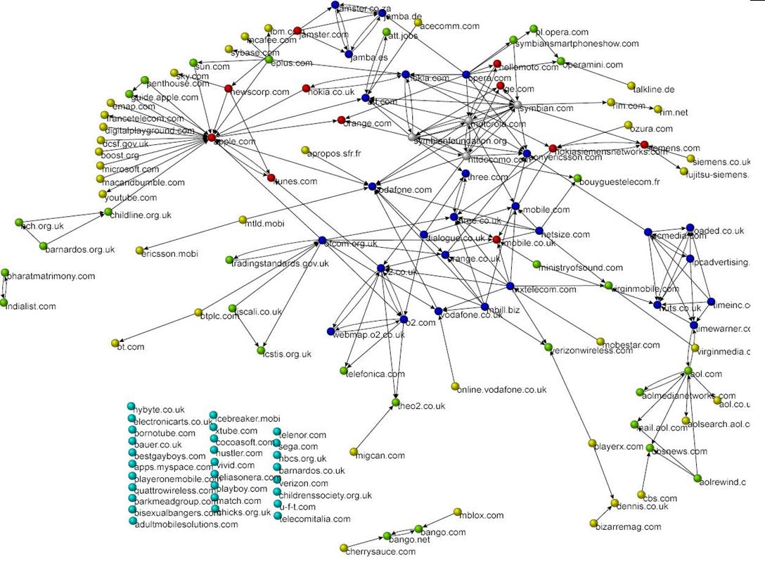

Graphs are Everywhere!
Transportation Networks.
Nodes: Airports; Edges: Nonstop flights.
Communication Networks.
Nodes: Computers; Edges: Physical links.
Information Networks.
Nodes: Webpages; Edges: Hyperlinks.
Social Networks.
Nodes: People; Edges: Friendship.
…

Slide 3
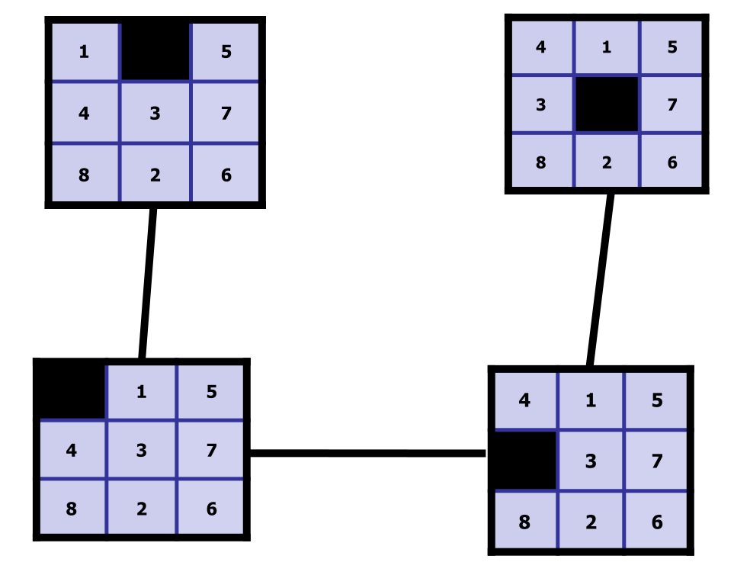
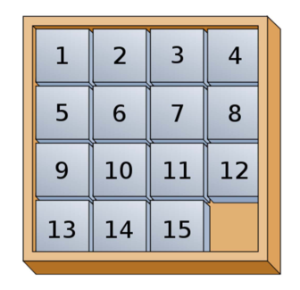

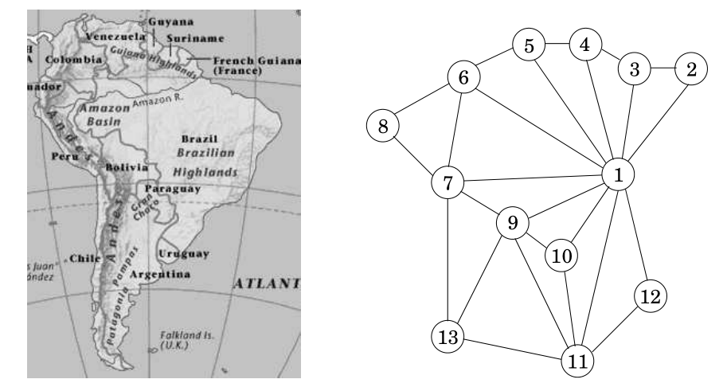
Graphs are Everywhere! Really!
Coloring Maps.
Nodes: Countries; Edges: Neighboring countries.
Question of Interest: Chromatic number?
Scheduling Exams.
Nodes: Exams; Edges: Conflicts.
Question of Interest: Chromatic number?
Solving Sliding Puzzle.
Nodes: States; Edges: Legit moves.
Question of Interest: Shortest path?
Solving Rubik’s Cube.
Nodes: States; Edges: Legit moves.
Question of Interest: Diameter?

Slide 4
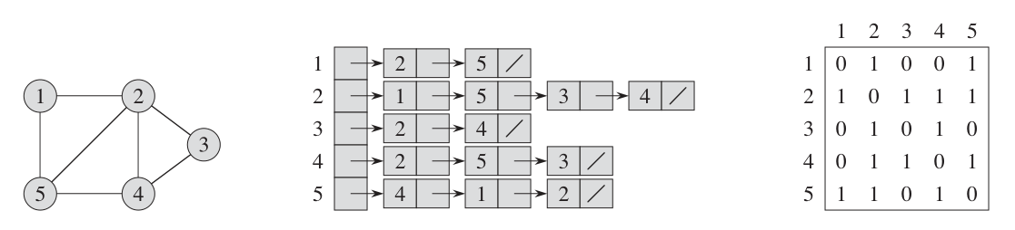
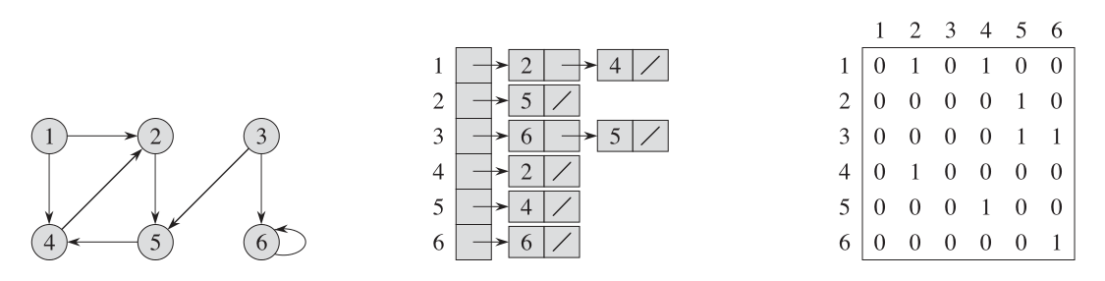

Representing graphs in computers Adjacency Matrix
Consider a graph $G=\left(V,E\right)$ where $\left|V\right|=n$ and $\left|E\right|=m$
The Adjacency Matrix of $G$ is an $n×n$ matrix $A=\left(a_{ij}\right)$ where $a_{ij}=\left\{{1 \atop 0} {if \left(i,j\right)∈E \atop otherwise}\right.$
The matrix will be symmetry if $G$ is undirected.
The matrix will always cost $Θ\left(n^{2}\right)$ memory, regardless of $m$.
Quick Question: What does $A^{2}$ mean, if anything?

Slide 5
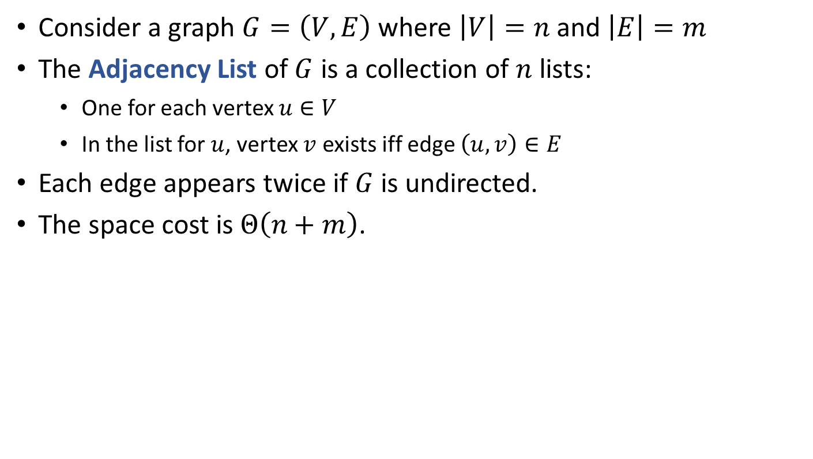
Representing graphs in computers Adjacency List
Consider a graph $G=\left(V,E\right)$ where $\left|V\right|=n$ and $\left|E\right|=m$
The Adjacency List of $G$ is a collection of $n$ lists:
One for each vertex $u∈V$
In the list for $u$, vertex $v$ exists iff edge $\left(u,v\right)∈E$
Each edge appears twice if $G$ is undirected.
The space cost is $Θ\left(n+m\right)$.

Slide 6
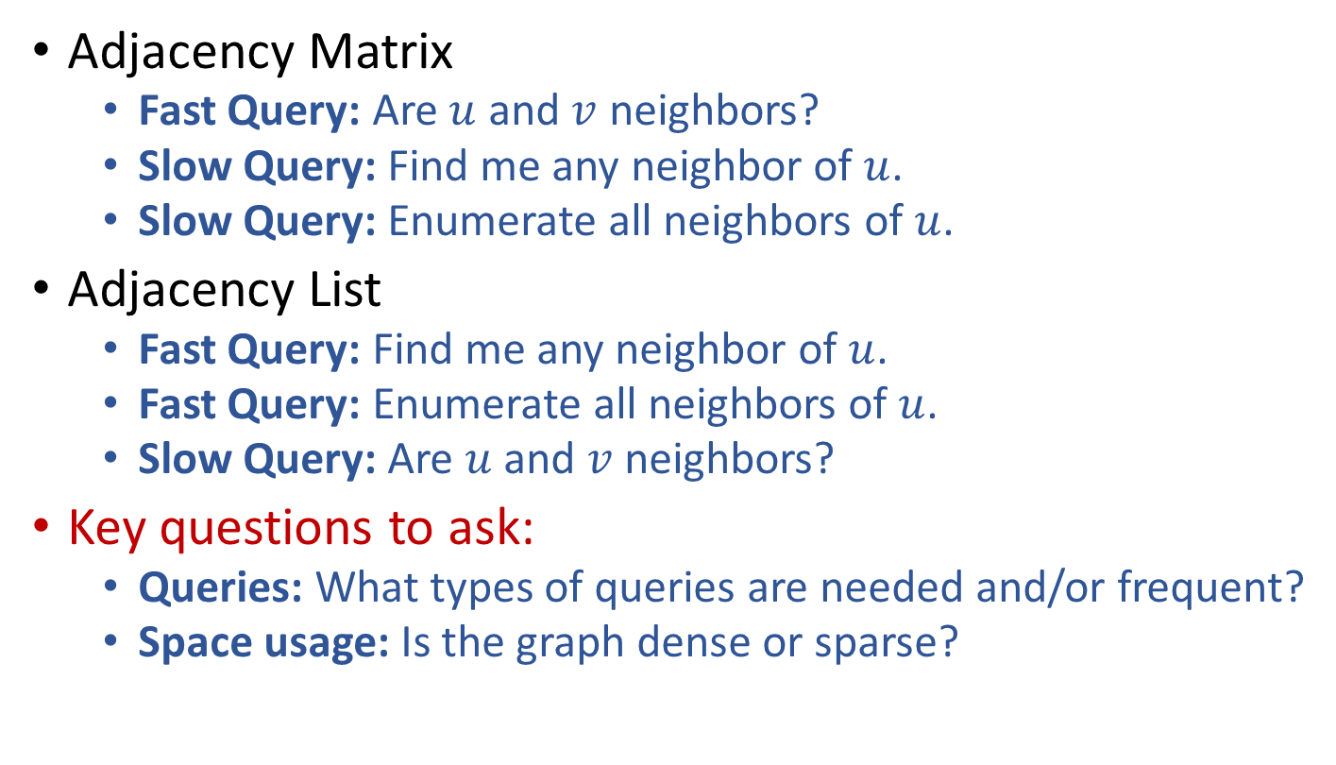
Adjacency Matrix and Adjacency List Trade-offs
Adjacency Matrix
Fast Query: Are $u$ and $v$ neighbors?
Slow Query: Find me any neighbor of $u$.
Slow Query: Enumerate all neighbors of $u$.
Adjacency List
Fast Query: Find me any neighbor of $u$.
Fast Query: Enumerate all neighbors of $u$.
Slow Query: Are $u$ and $v$ neighbors?
Key questions to ask:
Queries: What types of queries are needed and/or frequent?
Space usage: Is the graph dense or sparse?

Slide 7
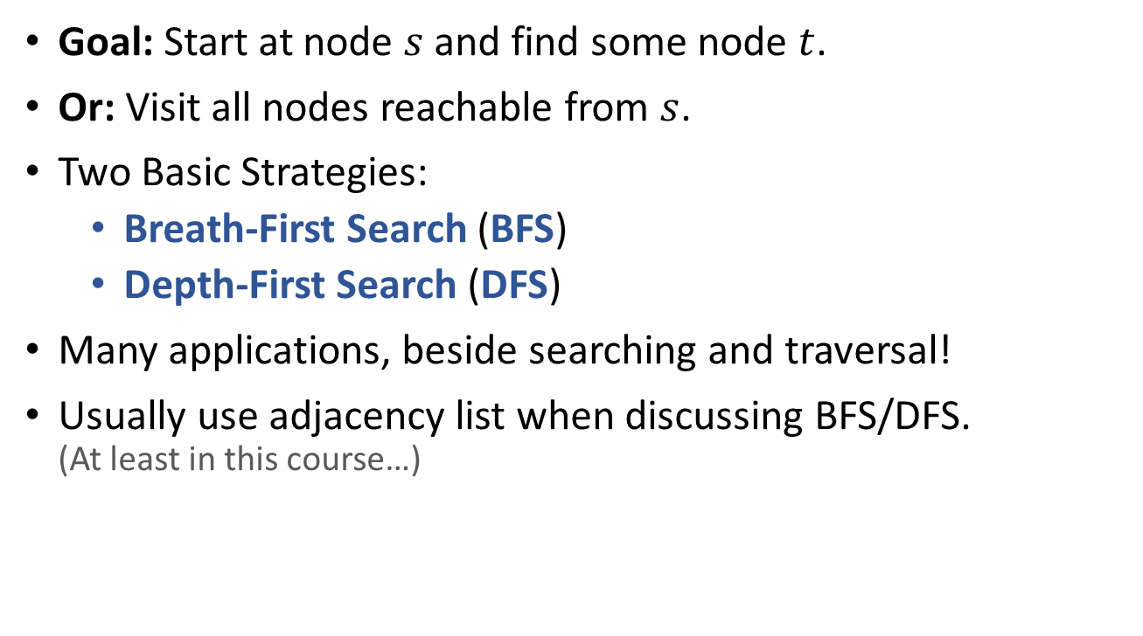
Searching in a Graph (or, Graph Traversal)
Goal: Start at node $s$ and find some node $t$.
Or: Visit all nodes reachable from $s$.
Two Basic Strategies:
Breath-First Search (BFS)
Depth-First Search (DFS)
Many applications, beside searching and traversal!
Usually use adjacency list when discussing BFS/DFS. (At least in this course…)

Slide 8
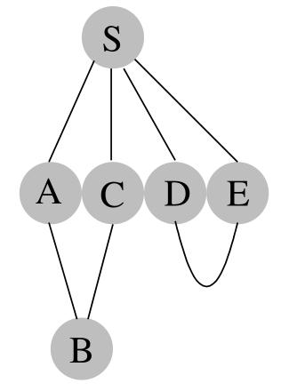
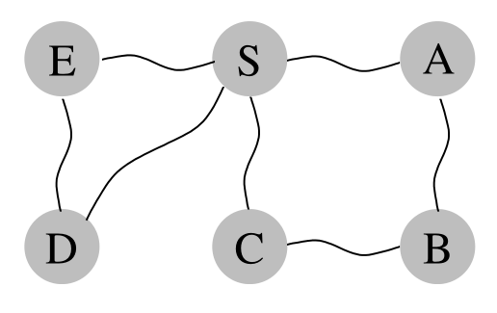
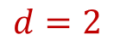
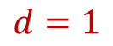
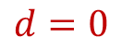


Breath-First Search (BFS)
Basic Idea of BFS:
Start at the source node $s$;
Visit other nodes (reachable from $s$) “layer by layer”.
A (somewhat) more precise description:
Start at the source node $s$;
Visit nodes at distance 1 from $s$;
Visit nodes at distance 2 from $s$;
…
These nodes are neighbors of distance 1 nodes!
Visit all distance $d$ nodes, before visit any distance $d+1$ node.
$$d=0$$
$$=1$$
$$d=2$$

Slide 9
BFS Implementation
BFSSkeleton(G,s):
for (each u in V)
u.dist=INF, u.visited=false
s.dist = 0
Q.enque(s)
while (!Q.empty())
u = Q.dequeue()
u.visited = true
for (each edge (u,v) in E)
if (!v.visited)
v.dist = u.dist+1
Q.enque(v)
How to implement BFS? (Hint: recall traversal-by-layer in trees)
Use a FIFO Queue!
Nodes have 3 status:
Undiscovered (WHITE): Not in queue yet.
Discovered but not visited (GRAY): In queue but not processed.
Visited (BLACK): Ejected from queue and processed.
We can “store” a shortest path, instead of only the length of the path.

Slide 10
BFS Implementation
BFS(G,s):
for (each u in V)
u.c = WHITE, u.d = INF, u.p = NIL
s.c = GRAY, s.d = 0, s.p = NIL
Q.enque(s)
while (!Q.empty())
u = Q.dequeue()
u.c = BLACK
for (each edge (u,v) in E)
if (v.c == WHITE)
v.c = GRAY
v.d = u.d+1
v.p = u
Q.enque(v)

Slide 11
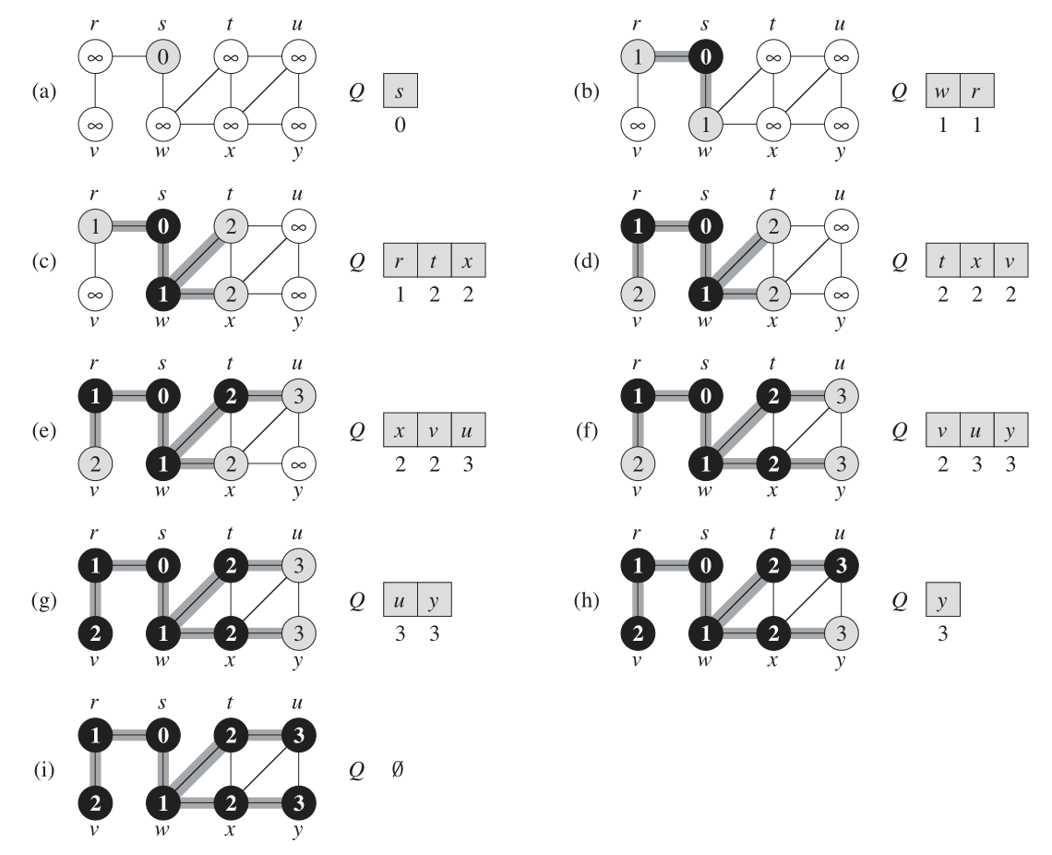
Sample Execution
BFS(G,s):
for (each u in V)
u.c=WHITE, u.d=INF, u.p=NIL
s.c=GRAY, s.d=0, s.p=NIL
Q.enque(s)
while (!Q.empty())
u = Q.dequeue()
u.c = BLACK
for (each edge (u,v) in E) {
if (v.c == WHITE)
v.c = GRAY
v.d = u.d+1
v.p = u
Q.enque(v)}
“else” clause?
first discovery (preprocessing)

Slide 12
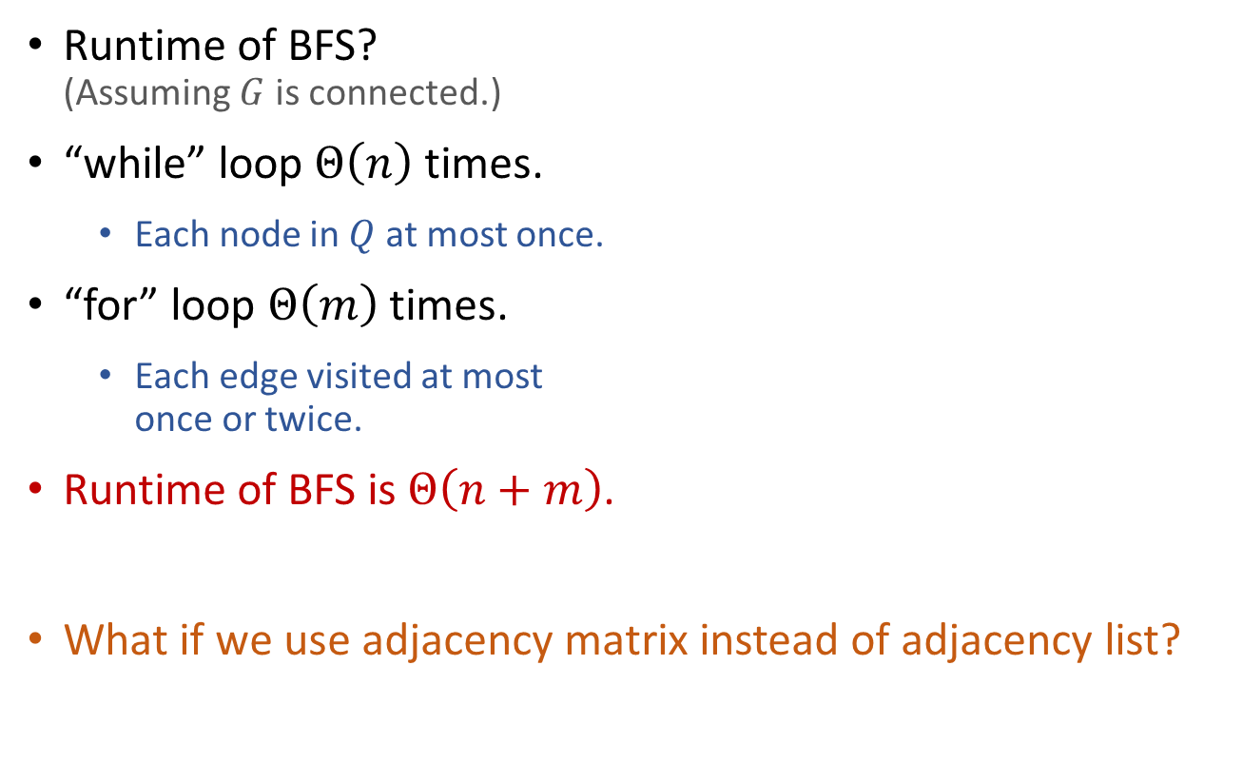
Performance of BFS
BFS(G,s):
for (each u in V)
u.c=WHITE, u.d=INF, u.p=NIL
s.c=GRAY, s.d=0, s.p=NIL
Q.enque(s)
while (!Q.empty())
u = Q.dequeue()
u.c = BLACK
for (each edge (u,v) in E)
if (v.c == WHITE)
v.c = GRAY
v.d = u.d+1
v.p = u
Q.enque(v)
Runtime of BFS? (Assuming $G$ is connected.)
“while” loop $Θ\left(n\right)$ times.
Each node in $Q$ at most once.
“for” loop $Θ\left(m\right)$ times.
Each edge visited at most once or twice.
Runtime of BFS is $Θ\left(n+m\right)$.
What if we use adjacency matrix instead of adjacency list?

Slide 13
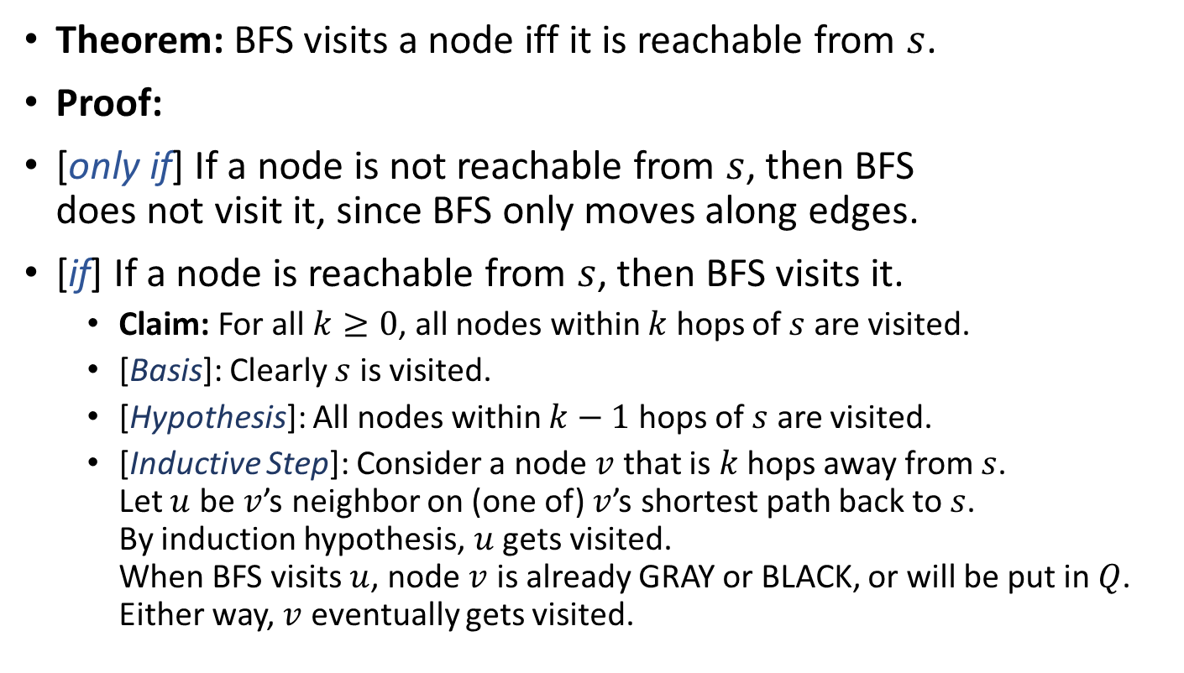
Correctness and Properties of BFS
Theorem: BFS visits a node iff it is reachable from $s$.
Proof:
[only if] If a node is not reachable from $s$, then BFS does not visit it, since BFS only moves along edges.
[if] If a node is reachable from $s$, then BFS visits it.
Claim: For all $k≥0$, all nodes within $k$ hops of $s$ are visited.
[Basis]: Clearly $s$ is visited.
[Hypothesis]: All nodes within $k−1$ hops of $s$ are visited.
[Inductive Step]: Consider a node $v$ that is $k$ hops away from $s$. Let $u$ be $v$’s neighbor on (one of) $v$’s shortest path back to $s$. By induction hypothesis, $u$ gets visited. When BFS visits $u$, node $v$ is already GRAY or BLACK, or will be put in $Q$. Either way, $v$ eventually gets visited.
Will this really happen?!

Slide 14
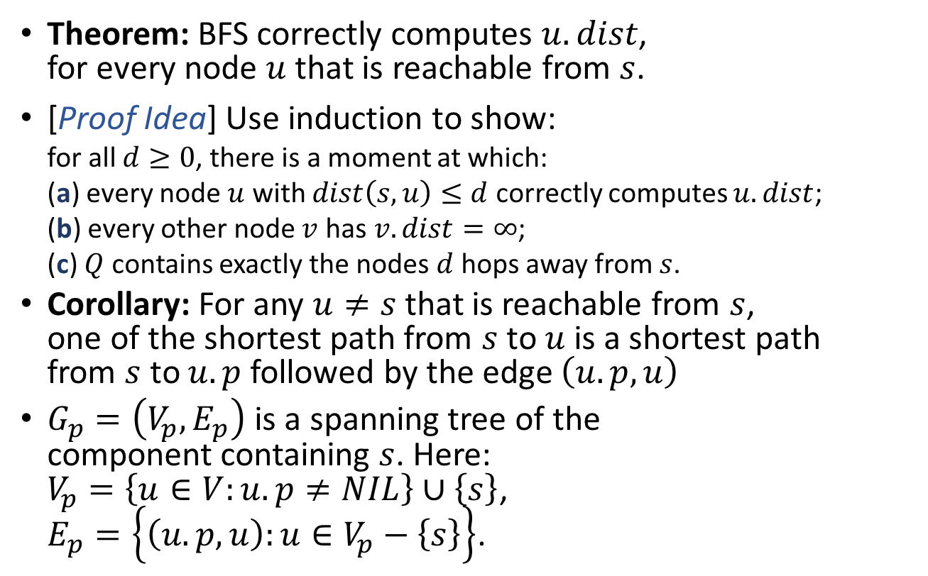
Correctness and Properties of BFS
Theorem: BFS correctly computes $u.dist$, for every node $u$ that is reachable from $s$.
[Proof Idea] Use induction to show: for all $d≥0$, there is a moment at which: (a) every node $u$ with $dist\left(s,u\right)≤d$ correctly computes $u.dist$; (b) every other node $v$ has $v.dist=∞$; (c) $Q$ contains exactly the nodes $d$ hops away from $s$.
Corollary: For any $u≠s$ that is reachable from $s$, one of the shortest path from $s$ to $u$ is a shortest path from $s$ to $u.p$ followed by the edge $\left(u.p,u\right)$
$G_{p}=\left(V_{p},E_{p}\right)$ is a spanning tree of the component containing $s$. Here: $V_{p}=\left\{u∈V:u.p≠NIL\right\}∪\left\{s\right\}$, $E_{p}=\left\{\left(u.p,u\right):u∈V_{p}−\left\{s\right\}\right\}$.

Slide 15
One last note on BFS
What if the graph is not connected?
Easy, do a BFS for each connected component!
BFS(G):
for (each u in V)
u.c = WHITE, u.d = INF, u.p = NIL
for (each u in V)
if (u.c == WHITE)
u.c = GRAY, u.d = 0, u.p = NIL
Q.enque(u)
while (!Q.empty())
v = Q.dequeue()
v.c = BLACK
for (each edge (v,w) in E)
if (w.c == WHITE)
w.c = GRAY
w.d = v.d+1
w.p = v
Q.enque(w)
Runtime of this procedure?

Slide 16
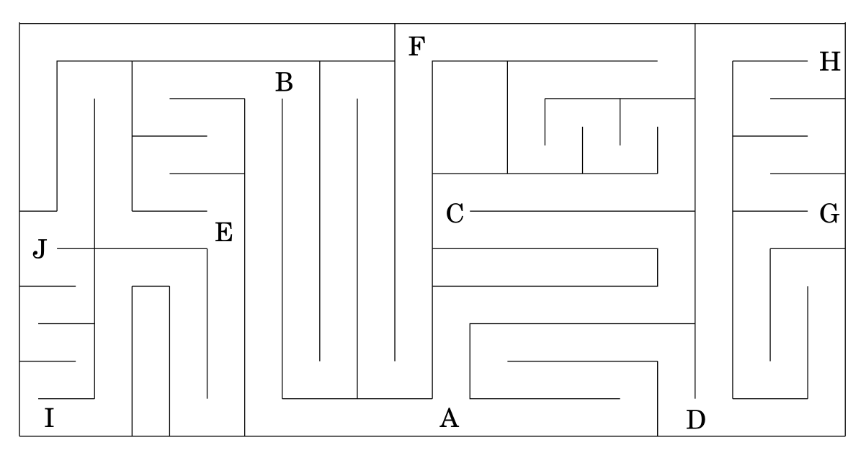
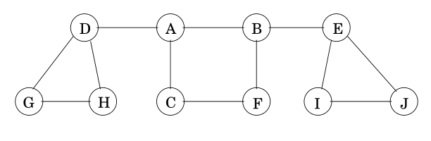
Depth-First Search (DFS)
Much like exploring a maze:
Use a ball of string and a piece of chalk.
Follow path (unwind string and mark at intersections), until stuck (reach dead-end or already-visited place).
Backtrack (rewind string), until find unexplored neighbor (intersection with unexplored direction).
Repeat above two steps.
How to do this for a graph, in computer?
Chalk: boolean variables.
String: a stack.
DFSSkeleton(G,s):
s.visited = true
for (each edge (s,v) in E)
if (!v.visited)
DFSSkelecton(G,v)
DFSIterSkeleton(G,s):
Stack Q
Q.push(s)
while (!Q.empty())
u = Q.pop()
if (!u.visited)
u.visited = true
for (each edge (u,v) in E)
Q.push(v)

Slide 17
A
B
A
B
A
B
A
B
DFSSkeleton(G,s):
s.visited = true
for (each edge (s,v) in E)
if (!v.visited)
DFSSkelecton(G,v)
D
C
D
C
D
C
D
C
A
B
A
B
A
B
A
B
A
B
D
C
D
C
D
C
D
C
D
C
DFSIterSkeleton(G,s):
Stack Q
Q.push(s)
while (!Q.empty())
u = Q.pop()
if (!u.visited)
u.visited = true
for (each edge (u,v) in E)
Q.push(v)
A
BCDA
CBCDA
CBCDA
A
B
A
B
A
B
A
B
D
C
D
C
D
C
D
C
BCDA
CDA
DA
DA
A
A
B
A
B
A
B
A
B
A
B
A
B
D
C
D
C
D
C
D
C
D
C
D
C

Slide 18
Depth-First Search (DFS)
Q: What if the graph is not (strongly) connected?
A: Do DFS from multiple sources.
DFSAll(G):
for (each node u)
u.visited = false
for (each node u)
if (u.visited == false)
DFSSkeleton(G,u)
DFSSkeleton(G,s):
s.visited = true
for (each edge (s,v) in E)
if (!v.visited)
DFSSkelecton(G,v)
DFSAll(G):
for (each node u)
u.visited = false
for (each node u)
if (u.visited == false)
DFSIterSkeleton(G,u)
DFSIterSkeleton(G,s):
Stack Q
Q.push(s)
while (!Q.empty())
u = Q.pop()
if (!u.visited)
u.visited = true
for (each edge (u,v) in E)
Q.push(v)

Slide 19
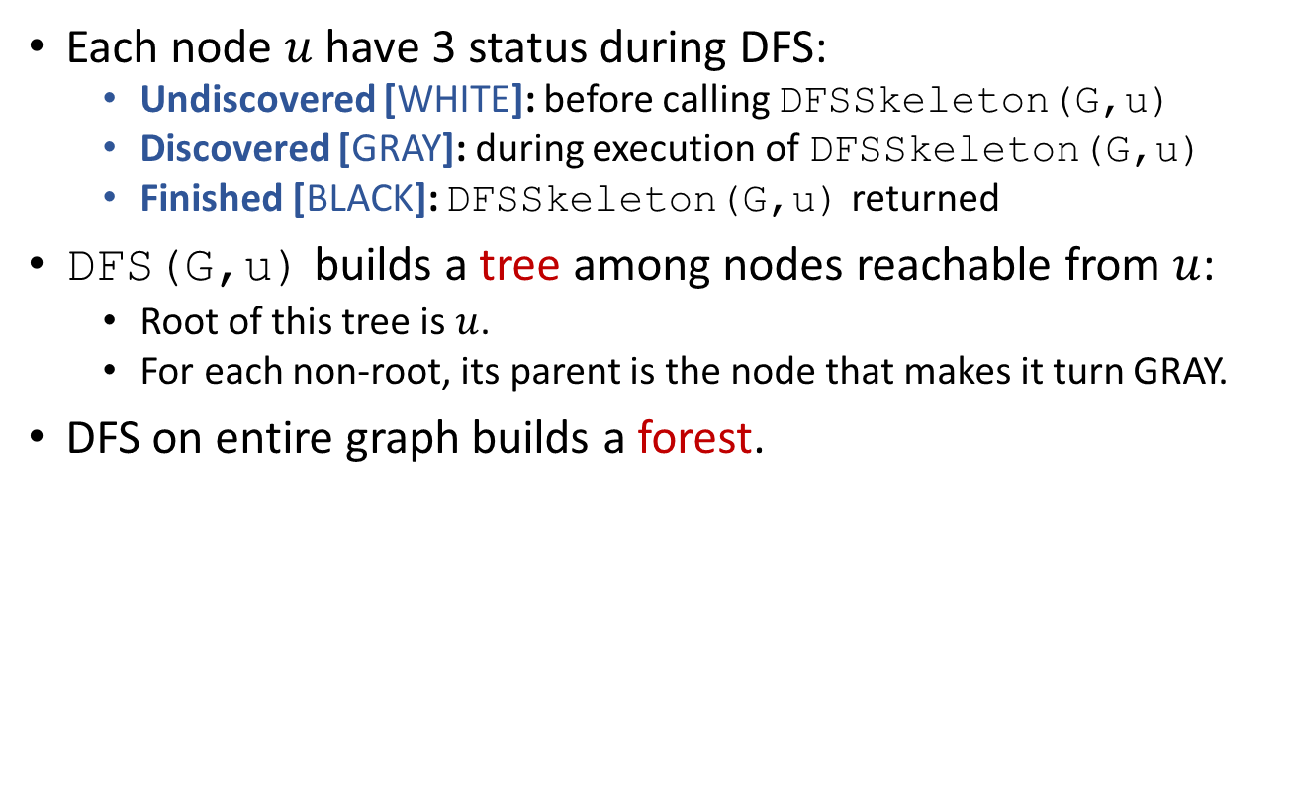
Depth-First Search (DFS)
Each node $u$ have 3 status during DFS:
Undiscovered [WHITE]: before calling DFSSkeleton(G,u)
Discovered [GRAY]: during execution of DFSSkeleton(G,u)
Finished [BLACK]: DFSSkeleton(G,u) returned
DFS(G,u) builds a tree among nodes reachable from $u$:
Root of this tree is $u$.
For each non-root, its parent is the node that makes it turn GRAY.
DFS on entire graph builds a forest.
DFSAll(G):
for (each node u)
u.color = WHITE
u.parent = NIL
for (each node u)
if (u.color == WHITE)
DFS(G,u)
DFS(G,s):
s.color = GRAY
for (each edge (s,v) in E)
if (v.color == WHITE)
v.parent = s
DFS(G,v)
s.color = BLACK

Slide 20
A
B
E
A
B
E
A
B
E
A
B
E
D
C
F
D
C
F
D
C
F
D
C
F
A
B
E
A
B
E
A
B
E
A
B
E
D
C
F
D
C
F
D
C
F
D
C
F
A
B
E
A
B
E
A
B
E
A
B
E
D
C
F
D
C
F
D
C
F
D
C
F
DFSAll(G):
for (each node u)
u.color = WHITE
u.parent = NIL
for (each node u)
if (u.color == WHITE)
DFS(G,u)
DFS(G,s):
s.color = GRAY
for (each edge (s,v) in E)
if (v.color == WHITE)
v.parent = s
DFS(G,v)
s.color = BLACK
A
B
E
D
C
F

Slide 21
Depth-First Search (DFS)
DFS provides (at least) two chances to process each node:
Pre-Visit: WHITE -> GRAY
Post-Visit: GRAY -> BLACK
Sample application: Track active intervals of nodes
Clock ticks whenever some node’s color changes.
Discovery time: when the node turn GRAY.
Finish time: when the node turn BLACK.
PreProcess(G):
time = 0
DFS(G,s):
PreVisit(s)
s.color = GRAY
for (each edge (s,v) in E)
if (v.color == WHITE)
v.parent = s
DFS(G,v)
s.color = BLACK
PostVisit(s)
DFSAll(G):
PreProcess(G)
for (each node u)
u.color = WHITE
u.parent = NIL
for (each node u)
if (u.color == WHITE)
DFS(G,u)
PreVisit(s):
time = time+1
s.d = time
PostVisit(s):
time = time+1
s.f = time

Slide 22
1,?
1,?
2,?
1,?
2,?
1,?
2,?
A
B
A
B
A
B
A
B
A
B
D
C
D
C
D
C
D
C
D
C
3,?
3,4
1,?
2,5
1,?
2,5
1,?
2,5
1,8
2,5
A
B
A
B
A
B
A
B
D
C
D
C
D
C
D
C
3,4
6,?
3,4
6,7
3,4
6,7
3,4
PreProcess(G):
time = 0
DFS(G,s):
PreVisit(s)
s.color = GRAY
for (each edge (s,v) in E)
if (v.color == WHITE)
v.parent = s
DFS(G,v)
s.color = BLACK
PostVisit(s)
DFSAll(G):
PreProcess(G)
for (each node u)
u.color = WHITE
u.parent = NIL
for (each node u)
if (u.color == WHITE)
DFS(G,u)
PreVisit(s):
time = time+1
s.d = time
PostVisit(s):
time = time+1
s.f = time

Slide 23

Runtime of DFS
Time spent on each node: $O\left(1\right)$
DFS(G,u) is called once for each node $u$.
Time spent on each edge: $O\left(1\right)$
Each edge is examined $O\left(1\right)$ times.
Total runtime: $O\left(n+m\right)$
PreProcess(G):
time = 0
DFS(G,s):
PreVisit(s)
s.color = GRAY
for (each edge (s,v) in E)
if (v.color == WHITE)
v.parent = s
DFS(G,v)
s.color = BLACK
PostVisit(s)
DFSAll(G):
PreProcess(G)
for (each node u)
u.color = WHITE
u.parent = NIL
for (each node u)
if (u.color == WHITE)
DFS(G,u)
PreVisit(s):
time = time+1
s.d = time
PostVisit(s):
time = time+1
s.f = time

Slide 24
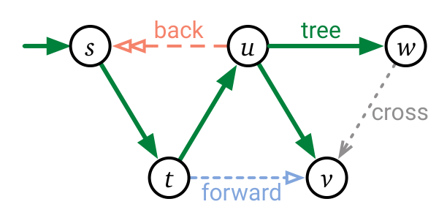
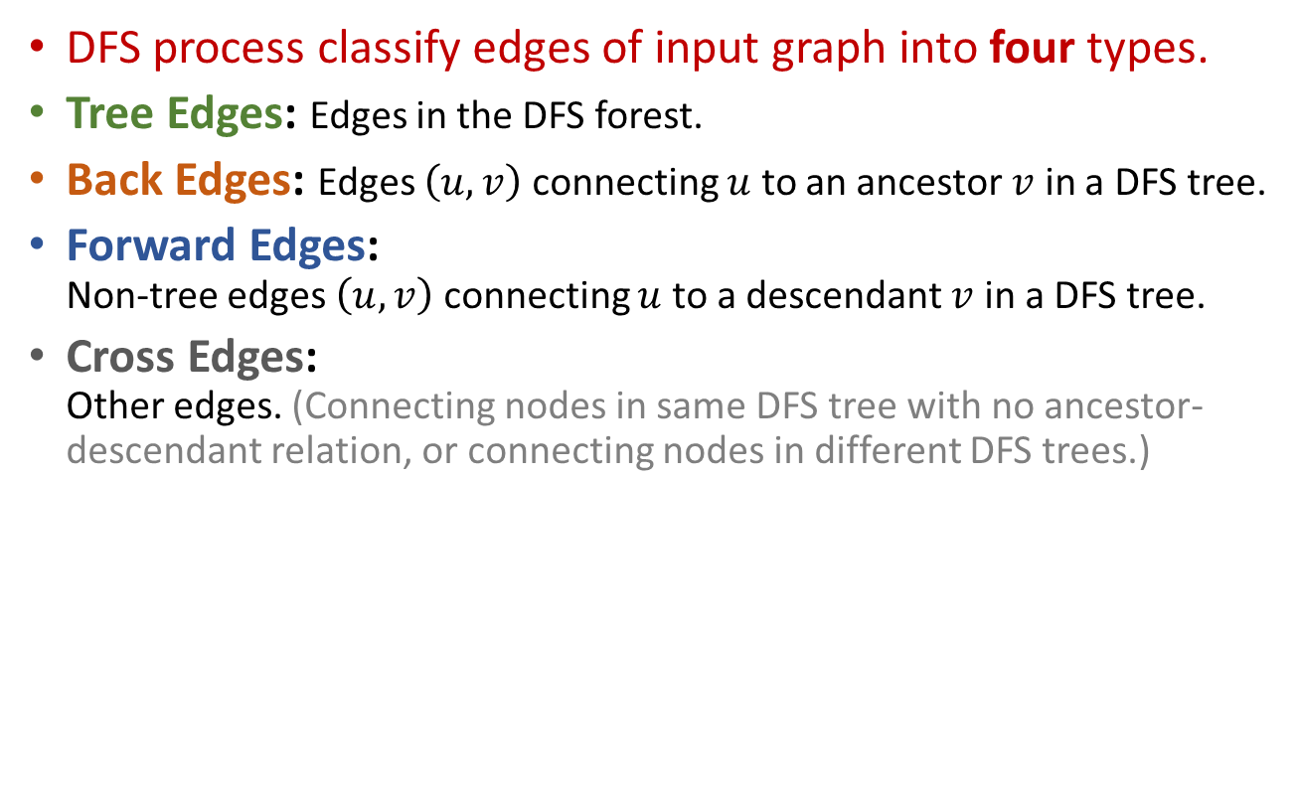
Classification of edges
DFS process classify edges of input graph into four types.
Tree Edges: Edges in the DFS forest.
Back Edges: Edges $\left(u,v\right)$ connecting $u$ to an ancestor $v$ in a DFS tree.
Forward Edges: Non-tree edges $\left(u,v\right)$ connecting $u$ to a descendant $v$ in a DFS tree.
Cross Edges: Other edges. (Connecting nodes in same DFS tree with no ancestor-descendant relation, or connecting nodes in different DFS trees.)
s
u
w
t
v

Slide 25
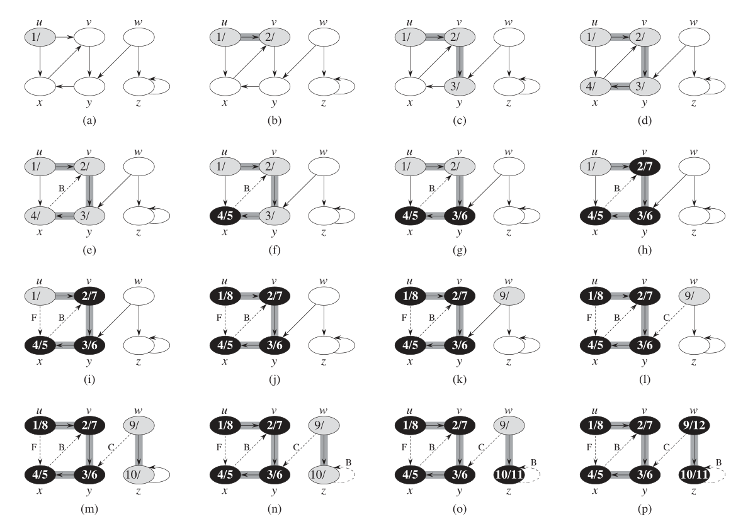

Slide 26
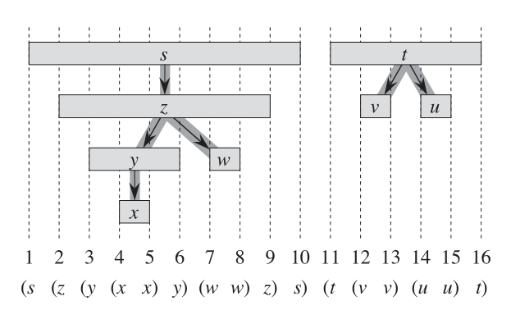
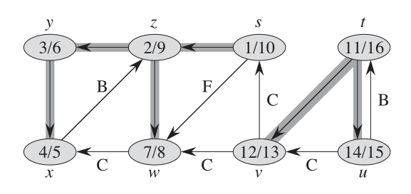

Properties of DFS Parenthesis Theorem
Active intervals of two nodes are either: (a) entirely disjoint; or (b) one is entirely contained within another.
For any two nodes $u$ and $v$, exactly one of following holds: (a) $\left[u.d,u.f\right]$ and $\left[v.d,v.f\right]$ are disjoint, and $u,v$ have no ancestor-descendant relation in the DFS forest; (b) $\left[u.d,u.f\right]⊂\left[v.d,v.f\right]$, and $u$ is a descendant of $v$ in a DFS tree; (c) $\left[v.d,v.f\right]⊂\left[u.d,u.f\right]$, and $u$ is an ancestor of $v$ in a DFS tree.

Slide 27
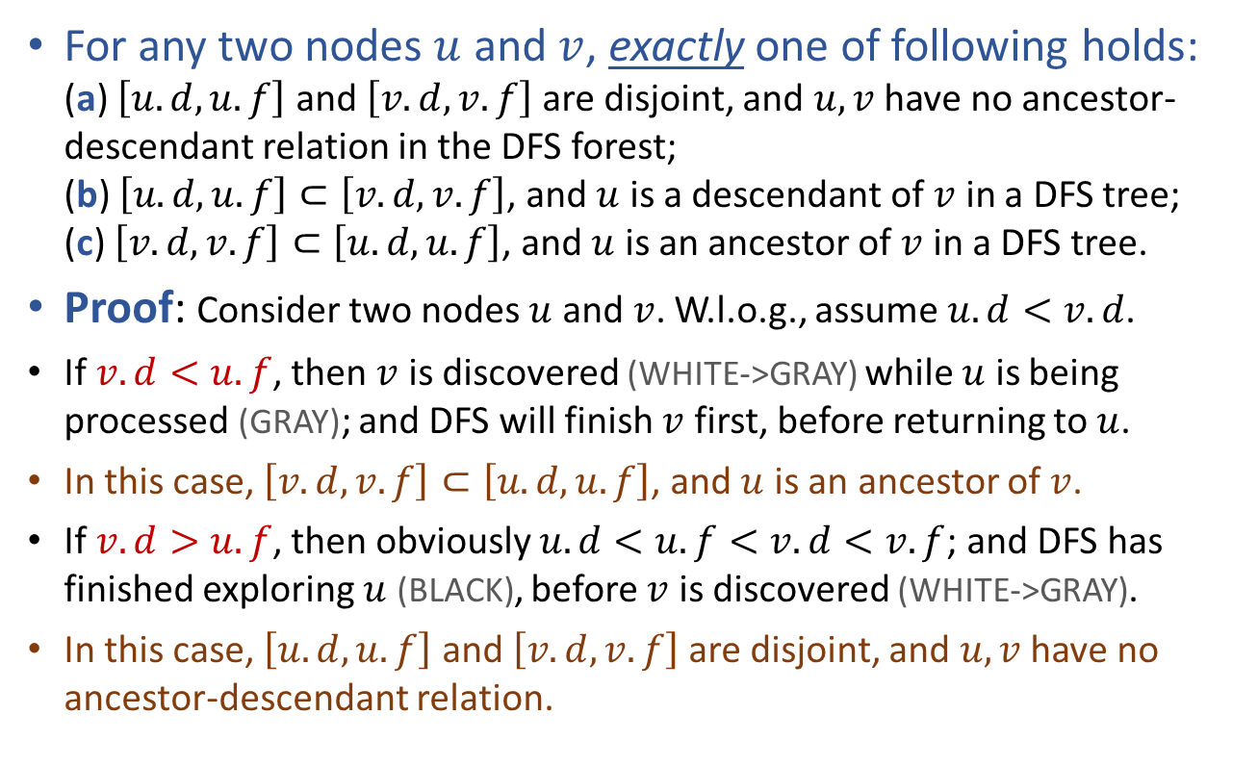
Properties of DFS Parenthesis Theorem
For any two nodes $u$ and $v$, exactly one of following holds: (a) $\left[u.d,u.f\right]$ and $\left[v.d,v.f\right]$ are disjoint, and $u,v$ have no ancestor-descendant relation in the DFS forest; (b) $\left[u.d,u.f\right]⊂\left[v.d,v.f\right]$, and $u$ is a descendant of $v$ in a DFS tree; (c) $\left[v.d,v.f\right]⊂\left[u.d,u.f\right]$, and $u$ is an ancestor of $v$ in a DFS tree.
Proof: Consider two nodes $u$ and $v$. W.l.o.g., assume $u.d<v.d$.
If $v.d<u.f$, then $v$ is discovered (WHITE->GRAY) while $u$ is being processed (GRAY); and DFS will finish $v$ first, before returning to $u$.
In this case, $\left[v.d,v.f\right]⊂\left[u.d,u.f\right]$, and $u$ is an ancestor of $v$.
If $v.d>u.f$, then obviously $u.d<u.f<v.d<v.f$; and DFS has finished exploring $u$ (BLACK), before $v$ is discovered (WHITE->GRAY).
In this case, $\left[u.d,u.f\right]$ and $\left[v.d,v.f\right]$ are disjoint, and $u,v$ have no ancestor-descendant relation.

Slide 28




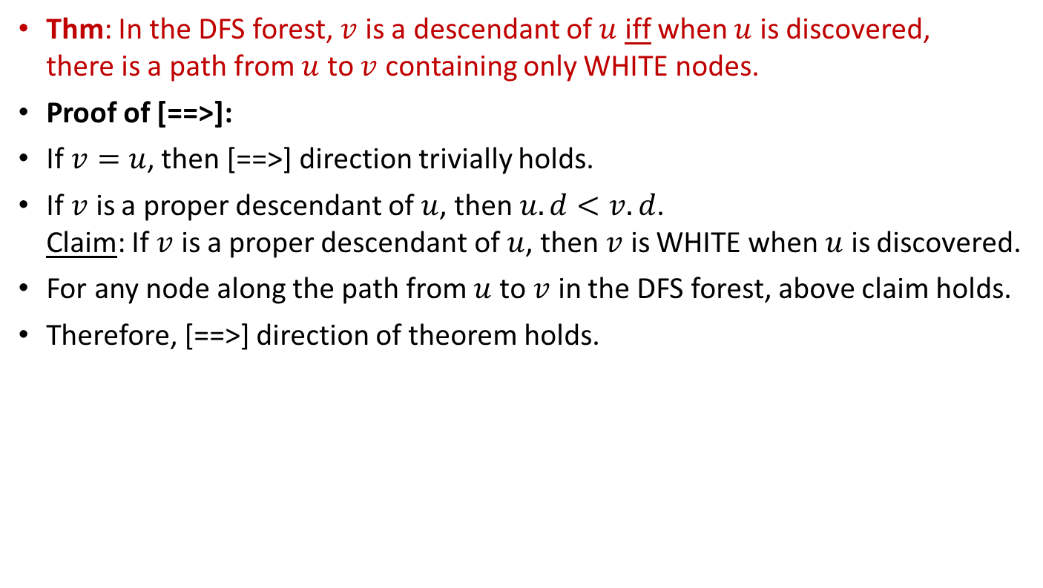
Properties of DFS White-path Theorem
Thm: In the DFS forest, $v$ is a descendant of $u$ iff when $u$ is discovered, there is a path from $u$ to $v$ containing only WHITE nodes.
Proof of [==>]:
If $v=u$, then [==>] direction trivially holds.
If $v$ is a proper descendant of $u$, then $u.d<v.d$. Claim: If $v$ is a proper descendant of $u$, then $v$ is WHITE when $u$ is discovered.
For any node along the path from $u$ to $v$ in the DFS forest, above claim holds.
Therefore, [==>] direction of theorem holds.
$$u$$
$$v_{1}$$
$$v_{2}$$
……
$$v$$
WHITE -> GRAY

Slide 29





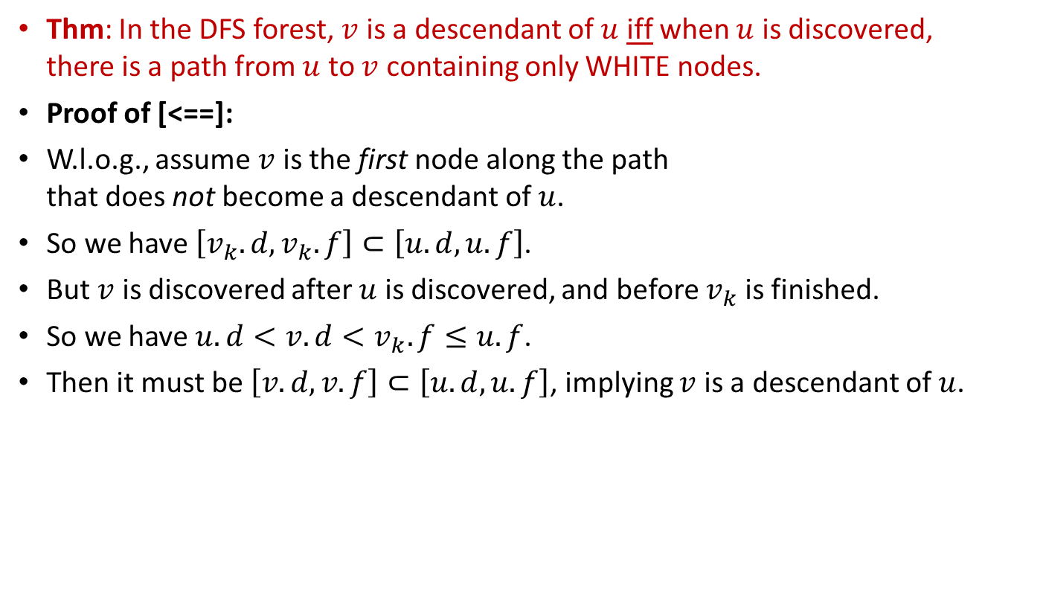
Properties of DFS White-path Theorem
Thm: In the DFS forest, $v$ is a descendant of $u$ iff when $u$ is discovered, there is a path from $u$ to $v$ containing only WHITE nodes.
Proof of [<==]:
W.l.o.g., assume $v$ is the first node along the path that does not become a descendant of $u$.
So we have $\left[v_{k}.d,v_{k}.f\right]⊂\left[u.d,u.f\right]$.
But $v$ is discovered after $u$ is discovered, and before $v_{k}$ is finished.
So we have $u.d<v.d<v_{k}.f≤u.f$.
Then it must be $\left[v.d,v.f\right]⊂\left[u.d,u.f\right]$, implying $v$ is a descendant of $u$.
$$u$$
$$v_{1}$$
$$v_{2}$$
……
$$v_{k}$$
$$v$$

Slide 30
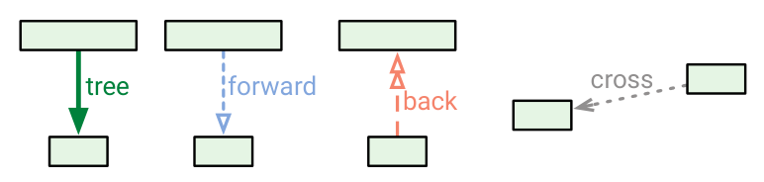
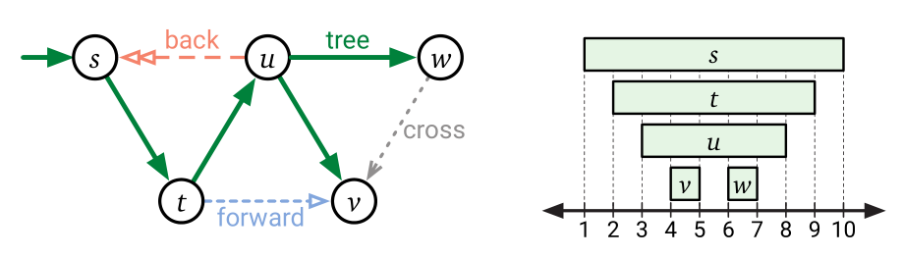





Properties of DFS Classification of edges
Determine $(u,v)$ type by color of $v$ during DFS execution.
Tree Edges: Edges in the DFS forest.
Back Edges: Edges $\left(u,v\right)$ connecting $u$ to an ancestor $v$ in a DFS tree.
Forward Edges: Non-tree edges $\left(u,v\right)$ connecting $u$ to a descendant $v$ in a DFS tree.
Cross Edges: Other edges. (Connecting nodes in same DFS tree with no ancestor-descendant relation, or connecting nodes in different DFS trees.)
Node $v$ is WHITE
Node $v$ is GRAY
Node $v$ is BLACK
Node $v$ is BLACK

Slide 31
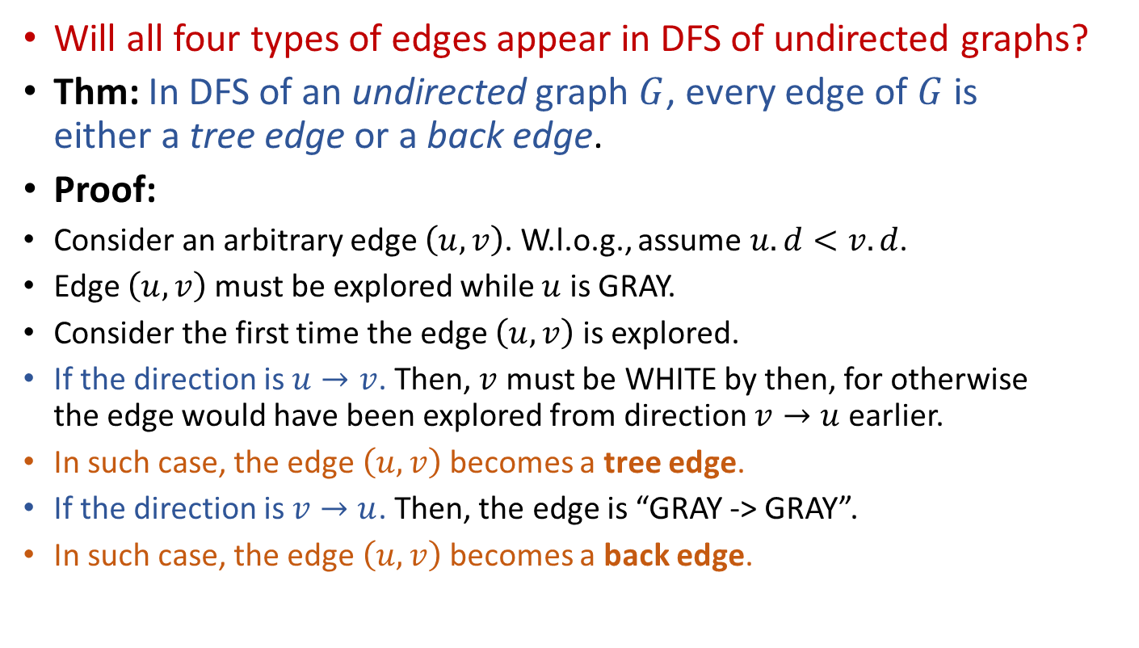
Properties of DFS Types of edges in undirected graphs
Will all four types of edges appear in DFS of undirected graphs?
Thm: In DFS of an undirected graph $G$, every edge of $G$ is either a tree edge or a back edge.
Proof:
Consider an arbitrary edge $\left(u,v\right)$. W.l.o.g., assume $u.d<v.d$.
Edge $\left(u,v\right)$must be explored while $u$ is GRAY.
Consider the first time the edge $\left(u,v\right)$ is explored.
If the direction is $u→v$. Then, $v$ must be WHITE by then, for otherwise the edge would have been explored from direction $v→u$ earlier.
In such case, the edge $\left(u,v\right)$becomes a tree edge.
If the direction is $v→u$. Then, the edge is “GRAY -> GRAY”.
In such case, the edge $\left(u,v\right)$becomes a back edge.

Slide 32
DFS, BFS, and others…
DFSIterSkeleton(G,s):
Stack Q
Q.push(s)
while (!Q.empty())
u = Q.pop()
if (!u.visited)
u.visited = true
for (each edge (u,v) in E)
Q.push(v)
BFSSkeletonAlt(G,s):
FIFOQueue Q
Q.enque(s)
while (!Q.empty())
u = Q.dequeue()
if (!u.visited)
u.visited = true
for (each edge (u,v) in E)
Q.enque(v)
GraphExploreSkeleton(G,s):
GenericQueue Q
Q.add(s)
while (!Q.empty())
u = Q.remove()
if (!u.visited)
u.visited = true
for (each edge (u,v) in E)
Q.add(v)
Other queuing disciplines lead to more interesting algorithms!

Slide 33
Reading
[CLRS] Ch.22 (22.1-22.3)

